Slide 1


SAP University Alliances
SAP4school – Education initiative to impart company processes in vocational schools
Speaker: XX
January 2022

Slide 2

Content
SAP4school IUS at a Glance
Success Story
Material Quote
What is Industry 4.0?
Outlook
Useful Links

Slide 3

SAP4school IUS at a Glance
What is SAP4school?
How can I participate?
Go to the SAP4school IUS homepage and find out more (+ new part of one of the info events; you can find dates for this on the home page)
If your school wants to use the SAP4 school offer, or if you have any questions, contact sap4school@integrus.de.
Signing of the Software License Agreement
Signature of hosting contract
Register for the next basic training course (dates can be found here)
What is the cost of participation?
SAP SE provides the software solution S/4 HANA on Prem free of charge for apprenticeships in vocational schools.
Hosting costs as at January 2022 are €950 plus VAT per school year
Advantages:
Teaching material is developed by teachers in vocational schools Actionable focus through case situations and hands-on working with documents Integration of business theory and business practice Modular, flexible structure of the course, depending on time and content requirements Annual new master data ensures end-to-end and error-free processing of business processes
SAP4school IUS is an educational initiative for teaching company processes in vocational schools.
The cooperation between ZSL-BW and ISB Bayern, SAP Young Thinkers, and UCC Magdeburg and Munich makes it possible to use the SAP software in classes.
Specialized teaching is at the heart of this. Embedded in this, we want to show how enterprise structures and operational business processes are mapped and supported by modern ERP software.
The curriculum has a three-level structure. The foundation modules (A modules) focus on learning about and understanding the organizational structures of the model company, maintaining basic master data, and the flow of basic business processes.
These processes will be deepened in the subsequent B modules. The offering is rounded off by Industry 4.0 modules that can be taught with or without the connection of real learning factories to the SAP4school IUS client.
Left
Material Quote: https://sap4school-ius.integrus.de/materialangebot.html Module Videos - ERP Flix https://erpflix.de/sap4school-lerneinheiten/ Podcast LEARNTEC https://podcast.opensap.info/education-newscast/2020/02/24/education-newscast-075-learntec-young-thinkers-und-sap4school/
Link to Home Page
Notes:
https://unsplash.com/photos/7z8PYdWZBwU

Slide 4







Success Story
Collaboration Agreement
Between SAP SE and the state of Baden-Württemberg.
2014
12 pilot schools
2015
Hands-on curriculum developed
on the ZSL with support from SAP and SAP UCC. SAP4school IUS* started with the aim of optimally integrating SAP ERP software into the teaching of vocational schools.
26 schools
SAP4school IUS cooperation between the ZSL and the State Institute for School Quality and Education Research Munich (ISB).
Program is spreading nationwide.
2017
90 schools
2021
Industry 4.0 in class
Versions:
I4.0 ETS/ELABO developed in collaboration with SAP UCC Magdeburg
I4.0 Fischer Technology Developed in Cooperation with SAP UCC Magdeburg
I4.0 developed in collaboration with ZSL/ISB and Festo Didactic CP Factory
  Version 1. Real Learning Factory
  Version 2. (CIROS) Simulation
270 schools
*IUS: Integrated business software

Slide 5
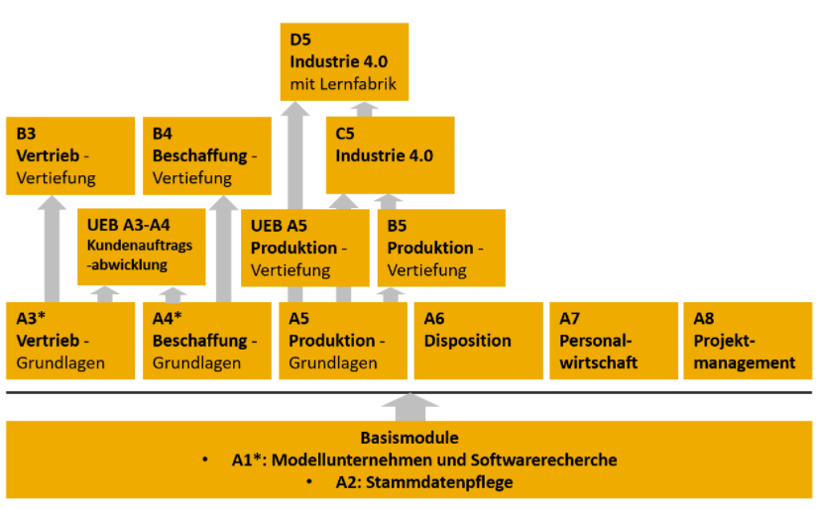

Material Offering SAP4school IUS
The curriculum has a three-level structure
Foundation modules (A modules):
Focus on getting to know and understand the organizational structures and standard business processes of the model company (for example, maintaining basic master data, simple procurement, production, and sales processes)
Additional B modules:
Deeper business processes (for example, handling returns, cash discounts, and discounts in sales and distribution)
Industry 4.0 modules (C and D modules):
with or without connecting real learning factories.
Material Quote
Industry 4.0
Depth Modules
Advantages:
Developed by teachers in vocational schools
Actionable focus through case situations and hands-on working with documents
Integration of business theory and business practice
Modular, flexible structure of the course, depending on time and content requirements
Annual new master data ensures end-to-end and error-free processing of business processes
Basic Modules Specialization
Base Modules
Figure Modules SAP4school IUS

Slide 6
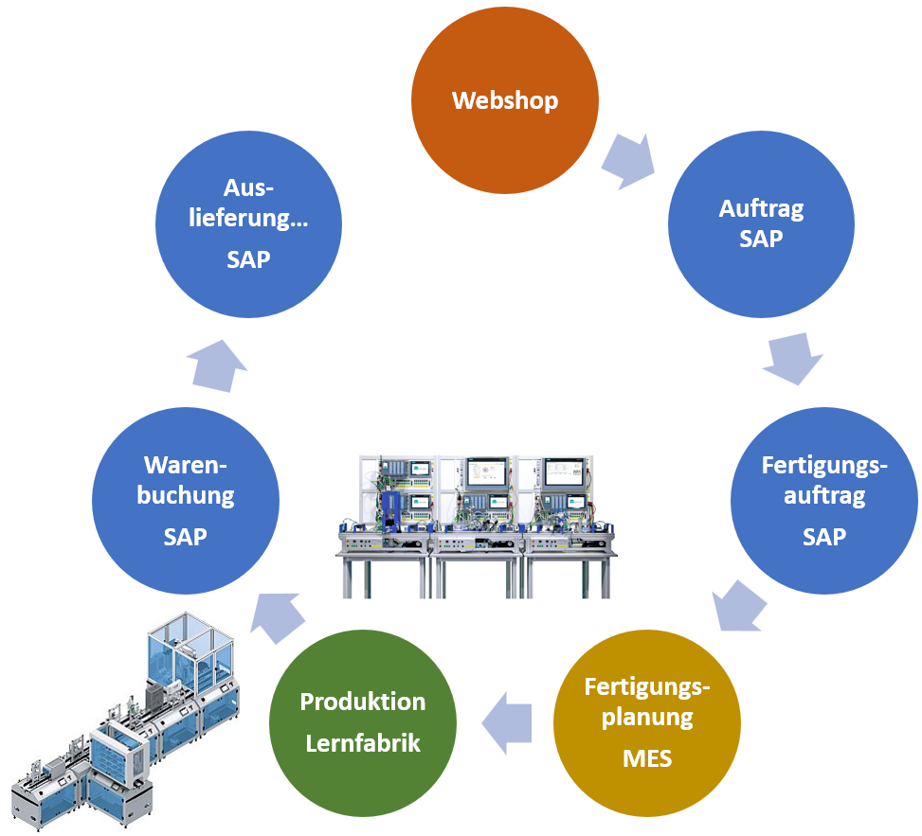

What is SAP4school IUS Industry 4.0?
SAP4school IUS Industry 4.0 modules:
By connecting ERP systems to learning factories, the entire value chain of modern companies can be mapped in practice. Strengthen the integration of commercial and commercial training courses, thus fostering mutual understanding of the respective process flows.
Options:
Without connection to a real learning factory -> Analysis of production with videos provided
Connection of an ETS/Elabo CPSi4.0 asset via SAP Manufacturing Execution (SAP ME)
Connection of a Festo Didactic CP Factory in two different versions.
  Version 1. Real Learning Factory
  Version 2. (CIROS) Simulation
Tip:
Video to open the learning factory 4.0 of the Rhein-Neckar district connected to the SAP4school IUS client
SAP Trainers Thursday Video presents the interaction between the SAP4school IUS client and a Festo learning factory.
Figure Industry 4.0 SAP4school IUS

Slide 7

Outlook
Project: SAP4school Move S/4 HANA
Goal: Make S/4 HANA on Premise available for SAP4school IUS schools for school year 22/23.

Slide 8



Useful Links
Homepages:
SAP4school IUS: https://sap4school-ius.integrus.de/home.html
SAP Young Thinkers: https://www.sap.com/about/young-thinkers.html
Material Quote: https://sap4school-ius.integrus.de/materialangebot.html
Module Videos - ERP Flix https://erpflix.de/sap4school-lerneinheiten/
Podcast LEARNTEC https://podcast.opensap.info/education-newscast/2020/02/24/education-newscast-075-learntec-young-thinkers-und-sap4school/
Support: sap4school@integrus.de
Become a member: https://sap4school-ius.integrus.de/mitglied-werden.html

Slide 9
Thank you.
Contact information: youngthinkers@sap.com

